Slide 1
OUR
RUBE GOLDBERG
PRESENTATION

Slide 2
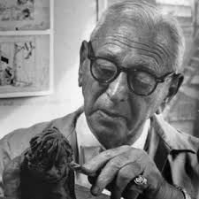
Who is Rube Goldberg
Rube Goldberg was born in san Fransico on July 4, 1883. Rube wasn’t just an engineer. He was also a cartoon artist, Sculptor, and Author. He is most famous for his inventions, the Rude Goldberg Machines where all machines that did simple tasks in a very complicated way.
That’s what STEM tried to simulate today.

Slide 3
Machine must haves
This machine must contain…………
-5 simple machine
-10 steps
-4 energy transfers
And
-look clean, high quality, and not look like it was made by a class of kindergardiners.

Slide 4
The 5 simple machines……………..

Slide 5
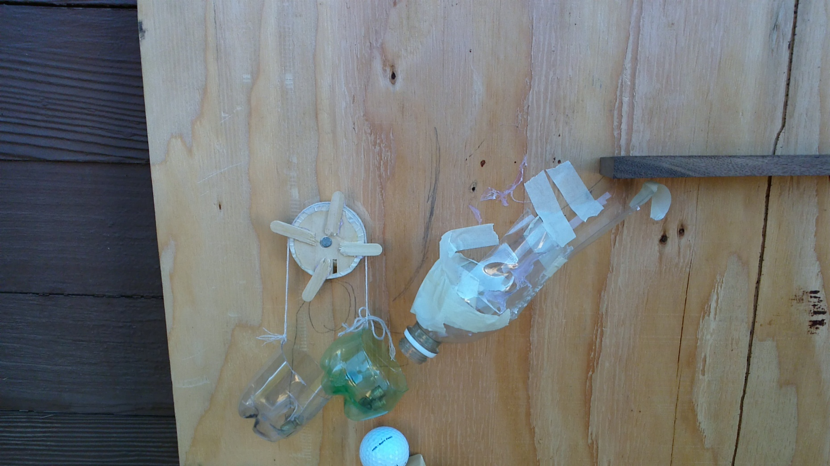
Pulley

Slide 6
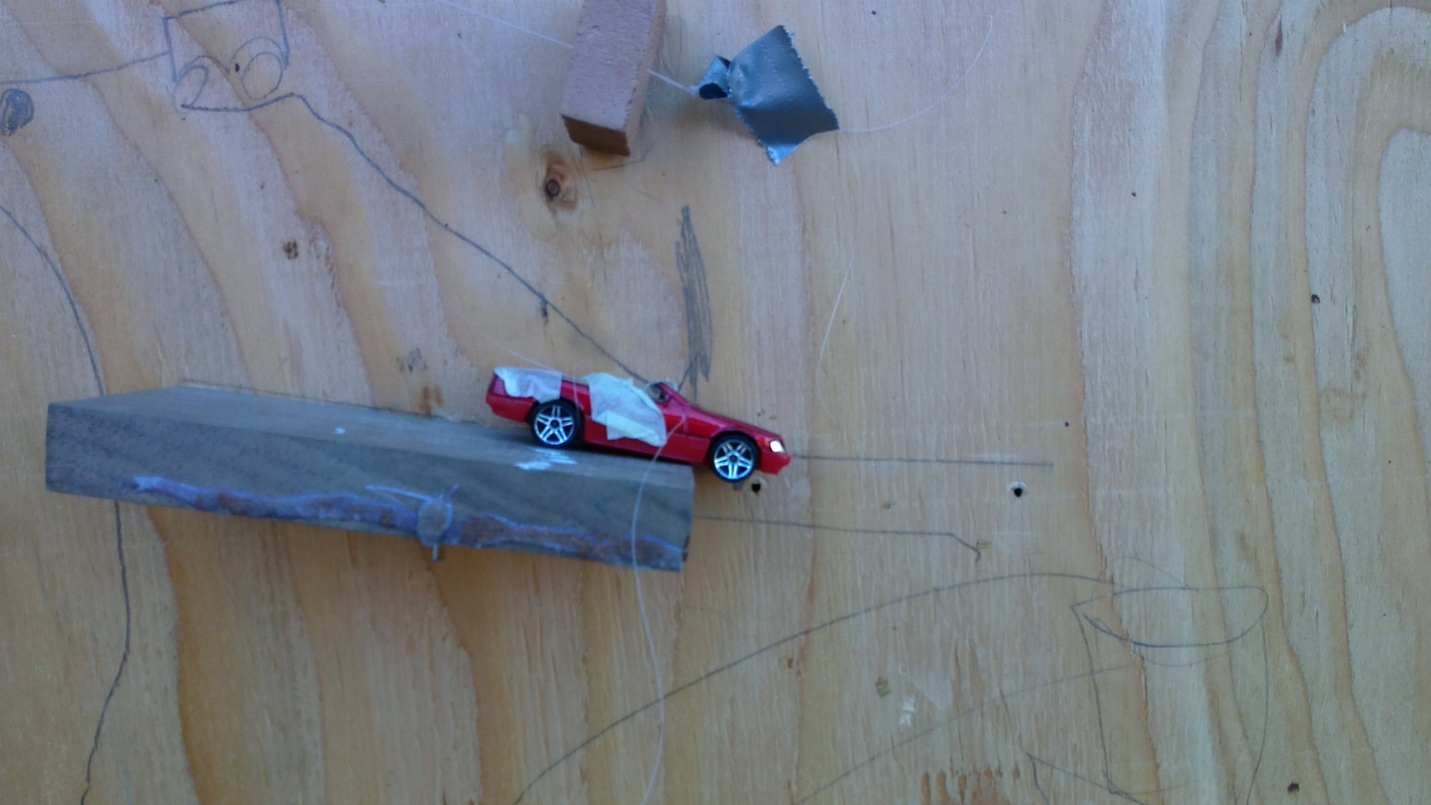
Wheel and Axle

Slide 7
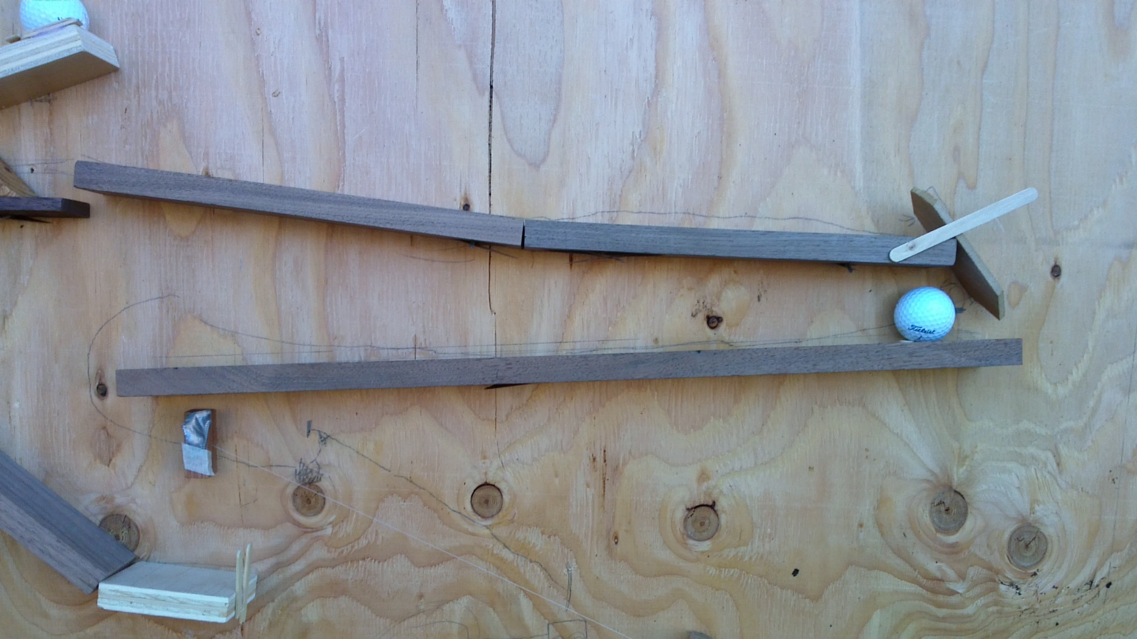
Inclined plane

Slide 8
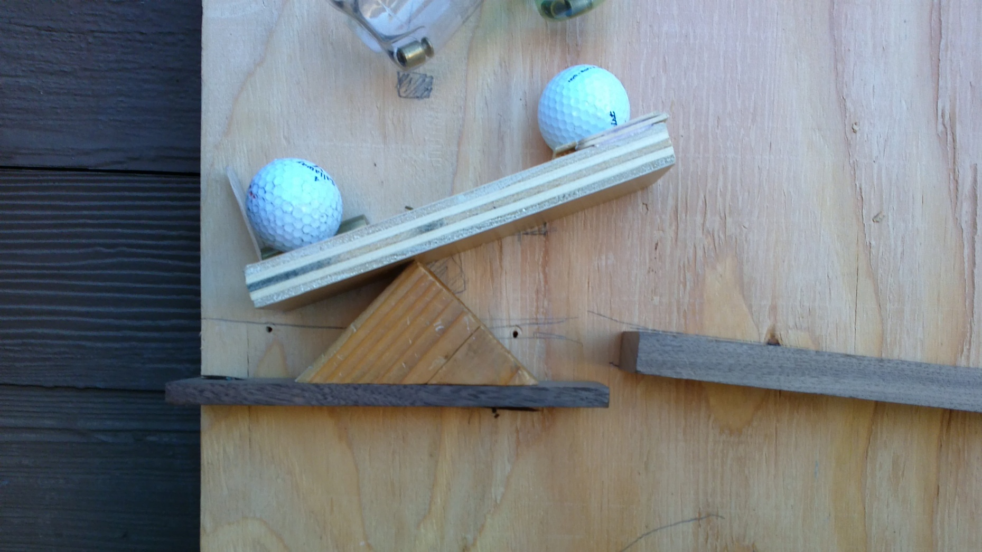
A lever

Slide 9
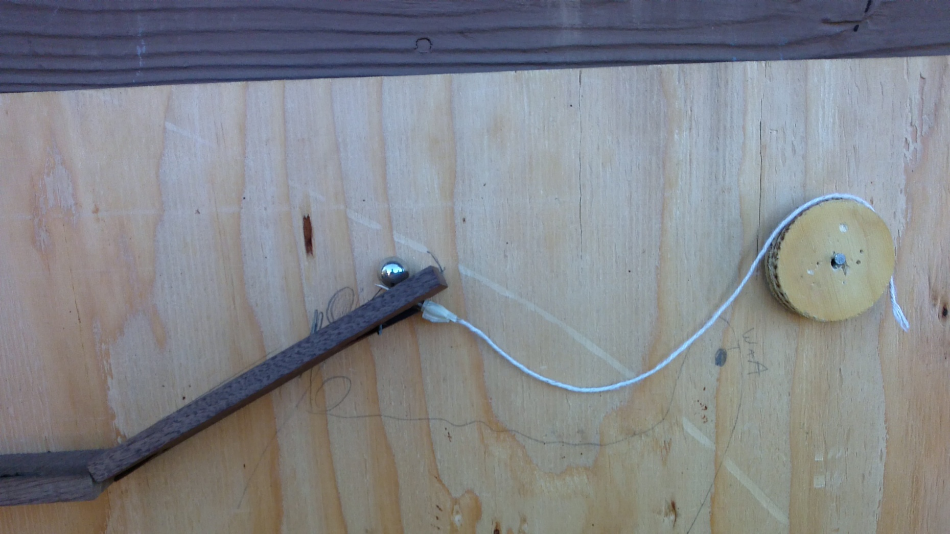
A Wedge

Slide 10
The 10 steps……………………….

Slide 11
Step 1
We pull the string

Slide 12
Step 2
String pulls on wedge

Slide 13
Step 3
Wedge gets pulled out

Slide 14
Step 4
Pinball rolls down inclined plane

Slide 15
Step 5
Pinball rolls into marble

Slide 16
Step 6
Marble and pinball fall into pulley system

Slide 17
Step 7
Pulley drops down

Slide 18
Step 8
Golf ball rolls down inclined plane

Slide 19
Step 9
Golf ball hits lever

Slide 20
Step 10
Lever moves other golf ball

Slide 21
Step 11
Golf ball rolls down inclined plane

Slide 22
Step 12
Golf ball hits lego man

Slide 23
Step 13
Lego man goes down zipline

Slide 24
Step 14
Lego hits car

Slide 25
Step 15
Car pulls the string

Slide 26
Step 16
Mentos drop in

Slide 27
Step 17
Soda shoots out of bottle

Slide 28
Step 18
Soda fills cup

Slide 29
TASK COMPLETE!

Slide 30
The 4 Energy Transfers

Slide 31
Transfer 1
Pinball to marble

Slide 32
Transfer 2
Golf ball to lever, lever to golf ball

Slide 33
Transfer 3
Golf ball to lego

Slide 34
Transfer 4
Lego to car

Slide 35
Construction Plan
What we wanted to do
What we actually did
Day 1:Plan on where to screw in wood
Day 2-7: Build and construct the machine
Day 8-9: Test and adjust
Day 10-11: Create and practice presentation
Day 1: Plan on placement of wood
Day 2-5:Build the entire machine
Day 5-10: Test to get the pulley to work properly
Day 11: Make this presentation

Slide 36
Fun fact
when potassium benzoate, aspartame, and CO2 gas contained in diet coke is combined with the gelatin and gum Arabic in mentos the rapid foaming occurs.

